Slide 1
The Axial Skeleton
Forms the longitudinal axis of the body
Divided into three parts
Skull
Vertebral column
Bony thorax

Slide 2
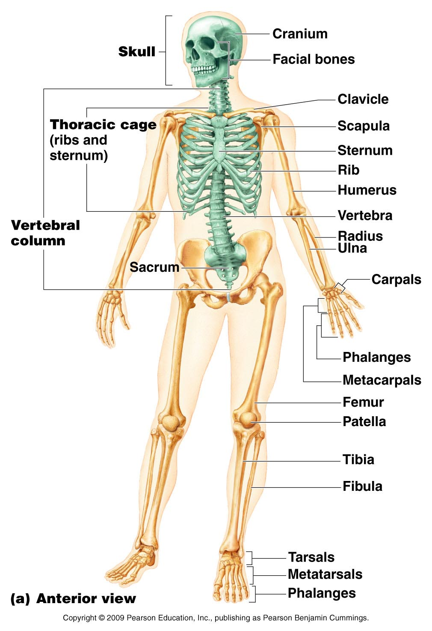
The Axial Skeleton
Figure 5.6a

Slide 3
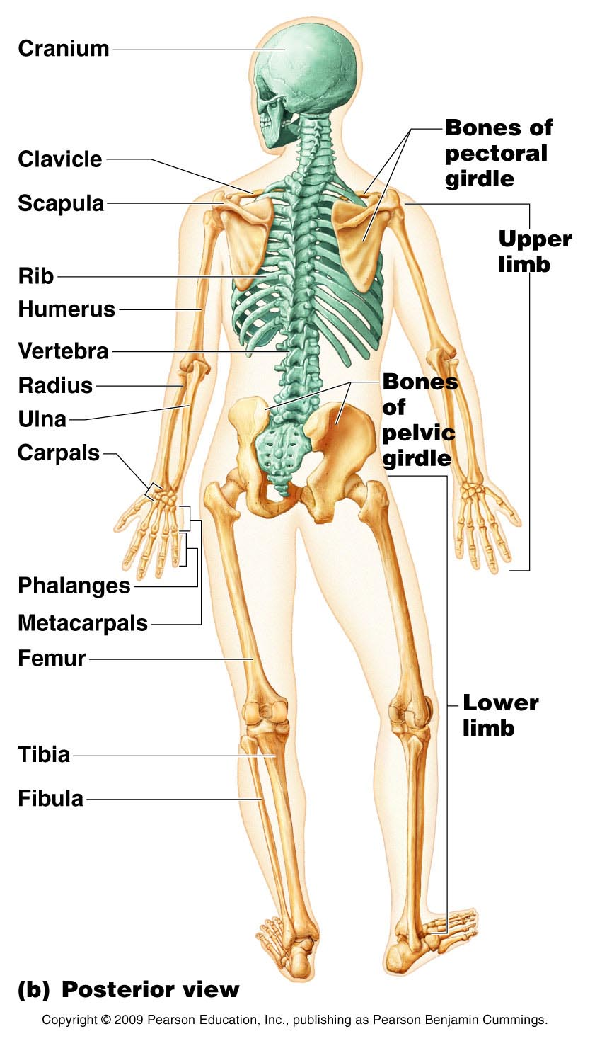
The Axial Skeleton
Figure 5.6b

Slide 4
The Skull
Two sets of bones
Cranium
Facial bones
Bones are joined by sutures
Only the mandible is attached by a freely movable joint

Slide 5
Paranasal Sinuses
Hollow portions of bones surrounding the nasal cavity
Functions of paranasal sinuses
Lighten the skull
Give resonance and amplification to voice

Slide 6
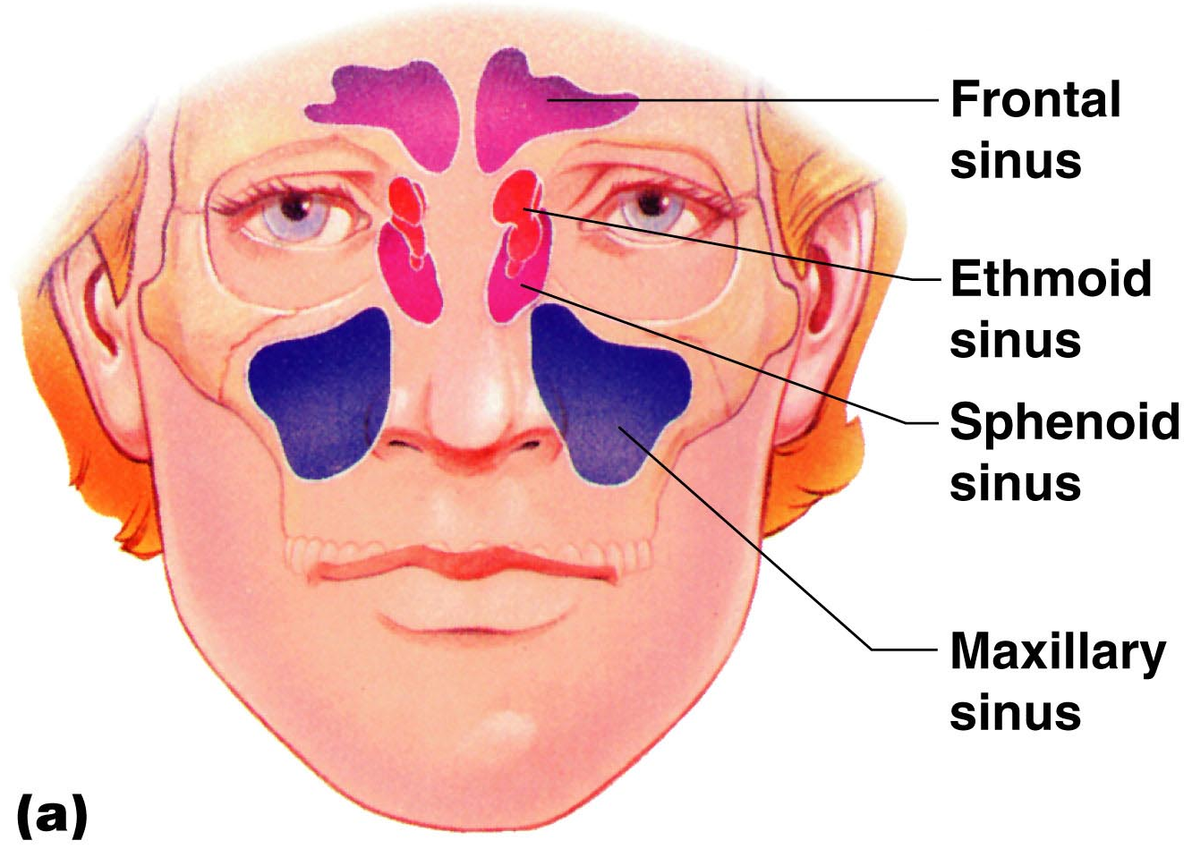
Paranasal Sinuses
Figure 5.10a

Slide 7
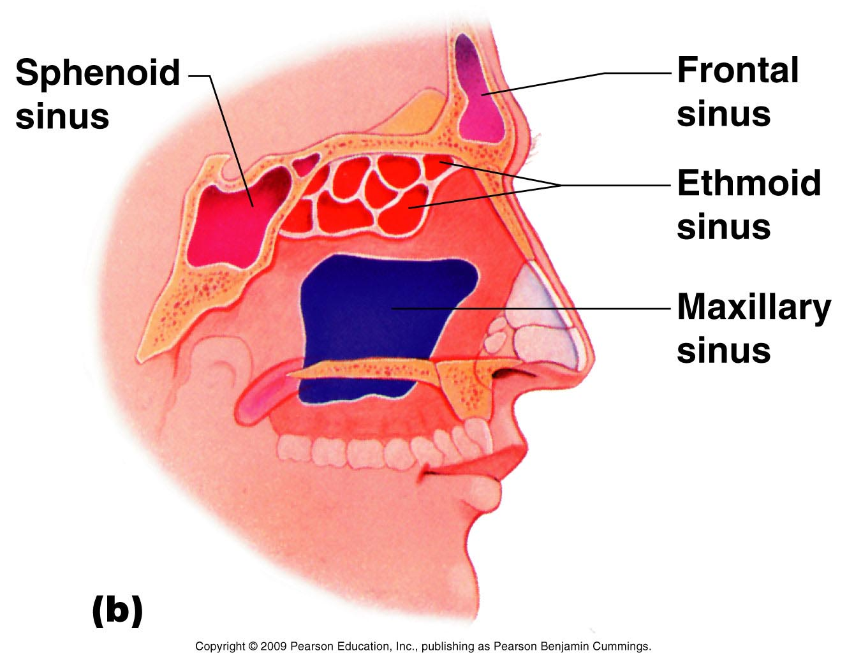
Paranasal Sinuses
Figure 5.10b

Slide 8
The Hyoid Bone
The only bone that does not articulate with another bone
Serves as a moveable base for the tongue
Aids in swallowing and speech

Slide 9
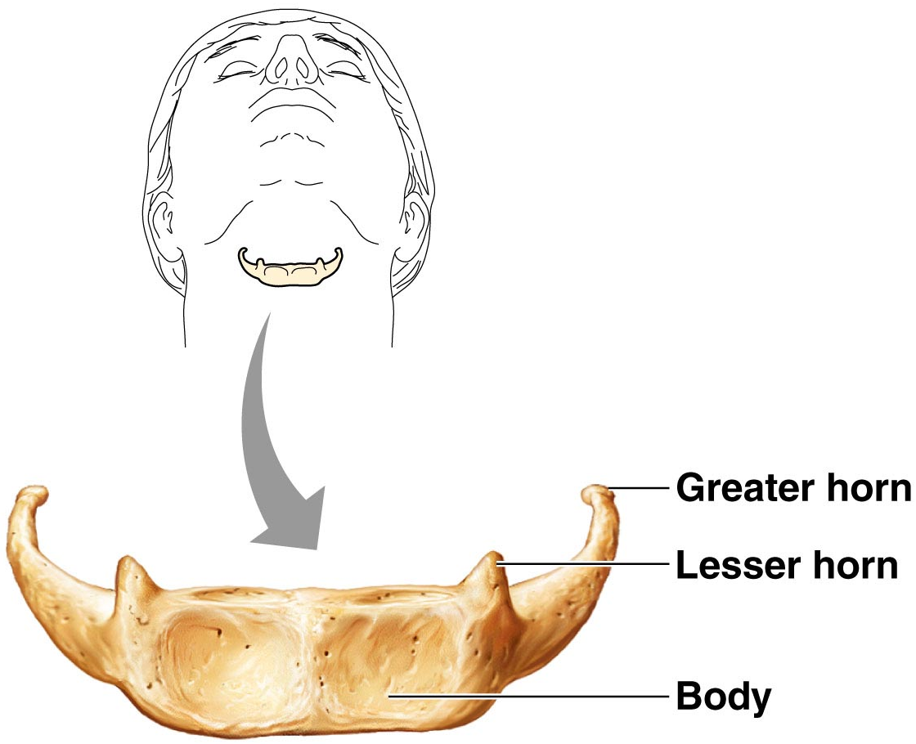
The Hyoid Bone
Figure 5.12

Slide 10
The Fetal Skull
The fetal skull is large compared to the infant’s total body length
Fontanels—fibrous membranes connecting the cranial bones
Allow the brain to grow
Convert to bone within 24 months after birth

Slide 11
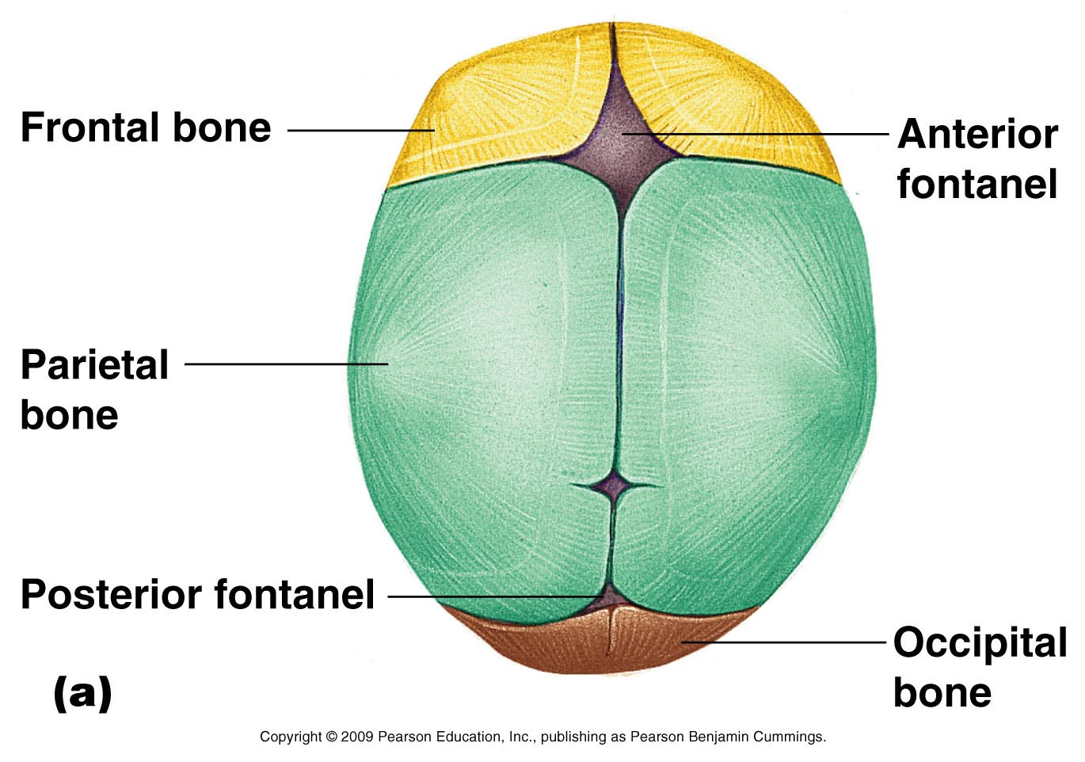
The Fetal Skull
Figure 5.13a

Slide 12
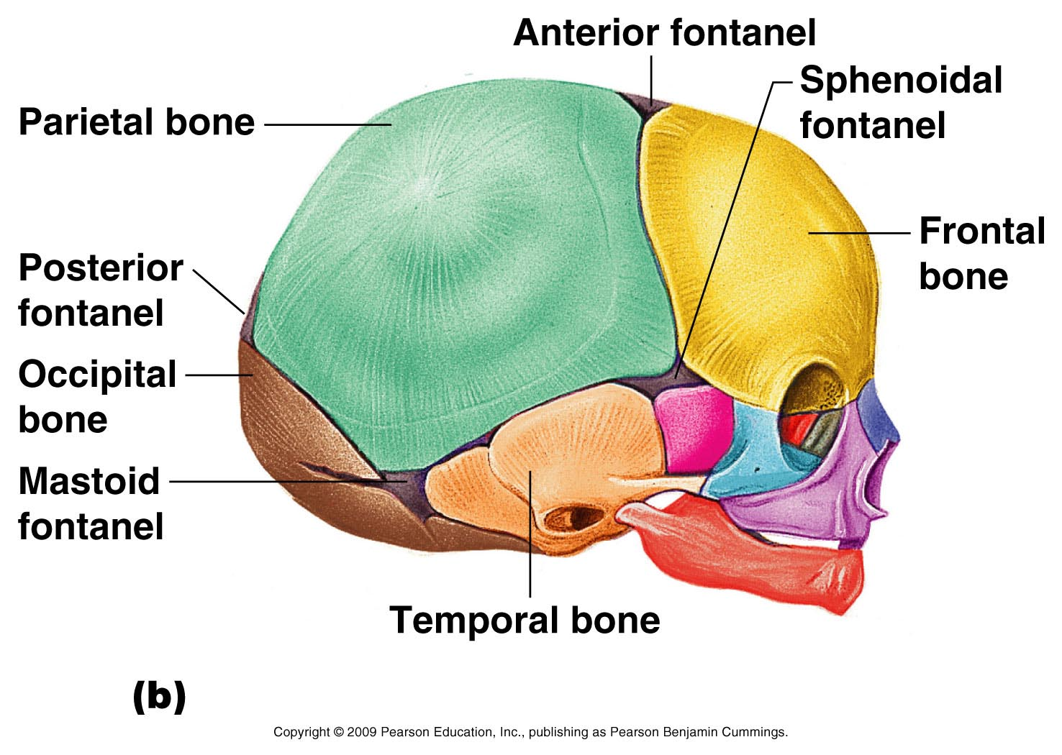
The Fetal Skull
Figure 5.13b

Slide 13
The Vertebral Column
Each vertebrae is given a name according to its location
There are 24 single vertebral bones separated by intervertebral discs
Seven cervical vertebrae are in the neck
Twelve thoracic vertebrae are in the chest region
Five lumbar vertebrae are associated with the lower back

Slide 14
The Vertebral Column
Nine vertebrae fuse to form two composite bones
Sacrum
Coccyx

Slide 15
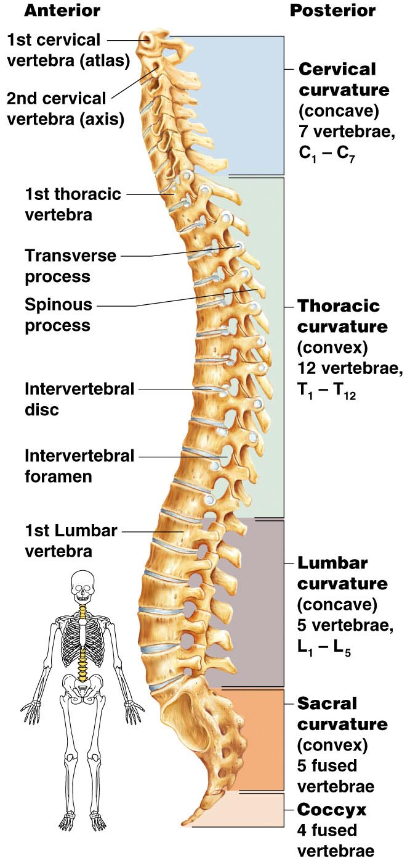
The Vertebral Column
Figure 5.14

Slide 16
The Vertebral Column
The spine has a normal curvature
Primary curvatures are the spinal curvatures of the thoracic and sacral regions
Present from birth
Secondary curvatures are the spinal curvatures of the cervical and lumbar regions
Develop after birth

Slide 17
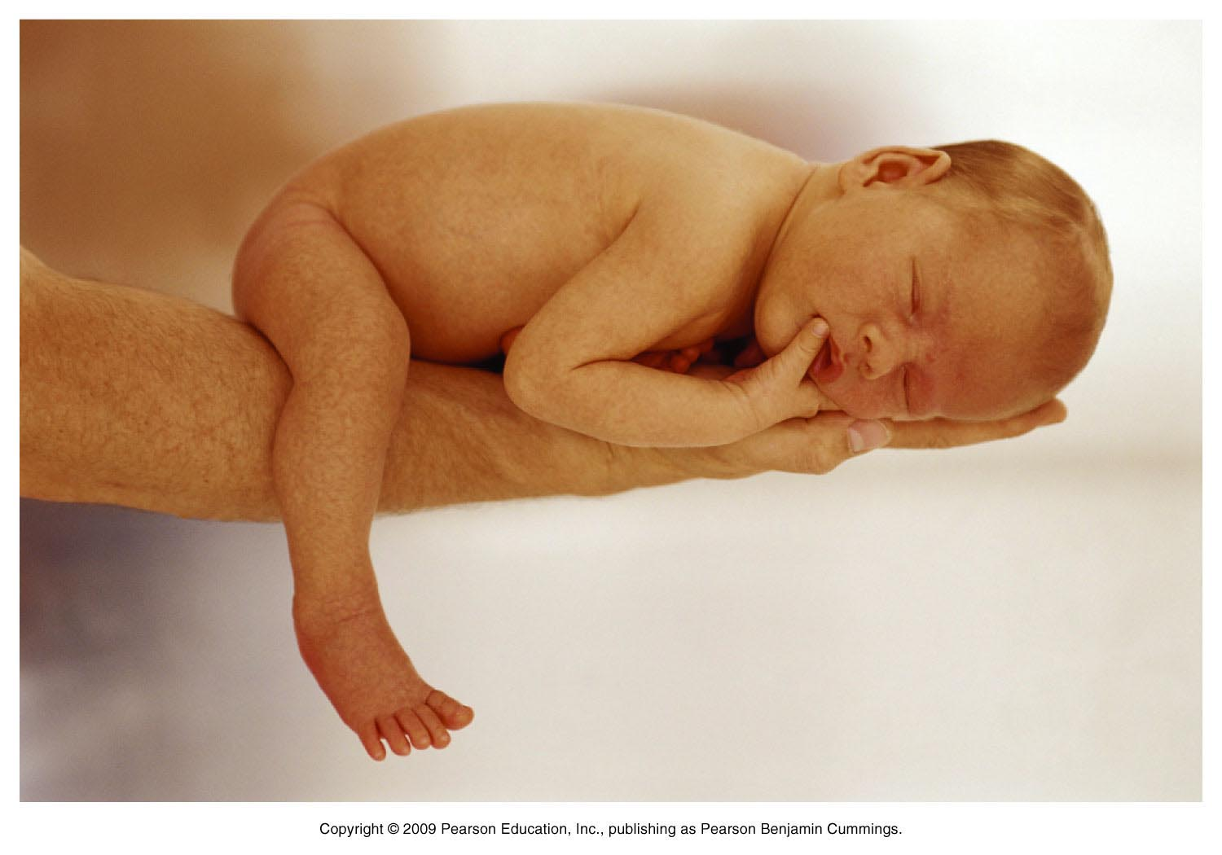
The Vertebral Column
Figure 5.15

Slide 18
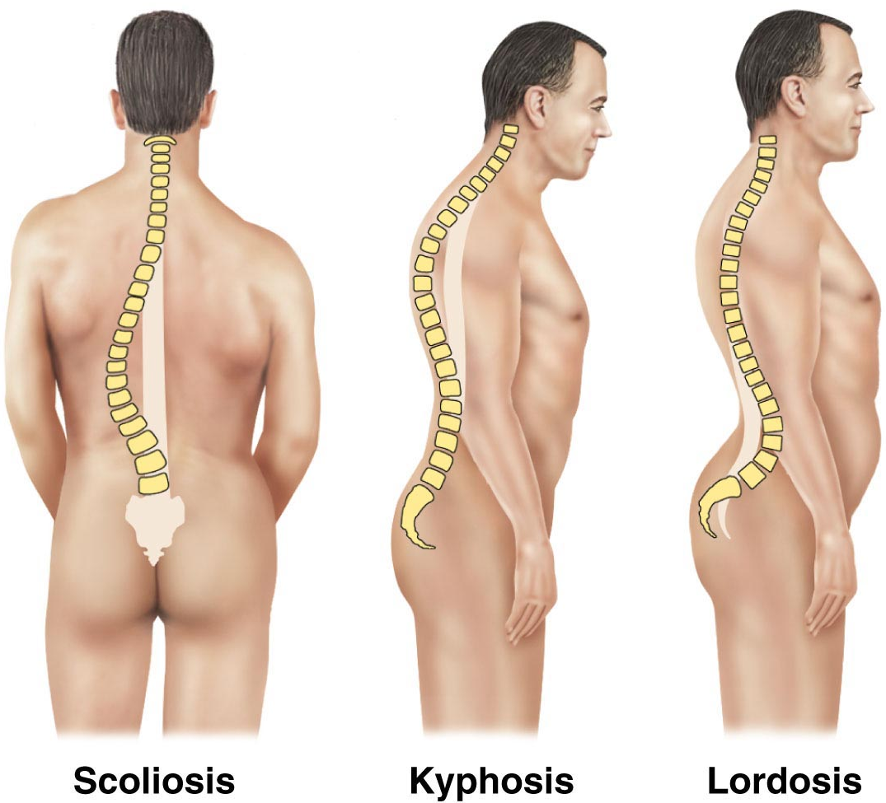
The Vertebral Column
Figure 5.16

Slide 19
Sacrum and Coccyx
Sacrum
Formed by the fusion of five vertebrae
Coccyx
Formed from the fusion of three to five vertebrae
“Tailbone,” or remnant of a tail that other vertebrates have

Slide 20
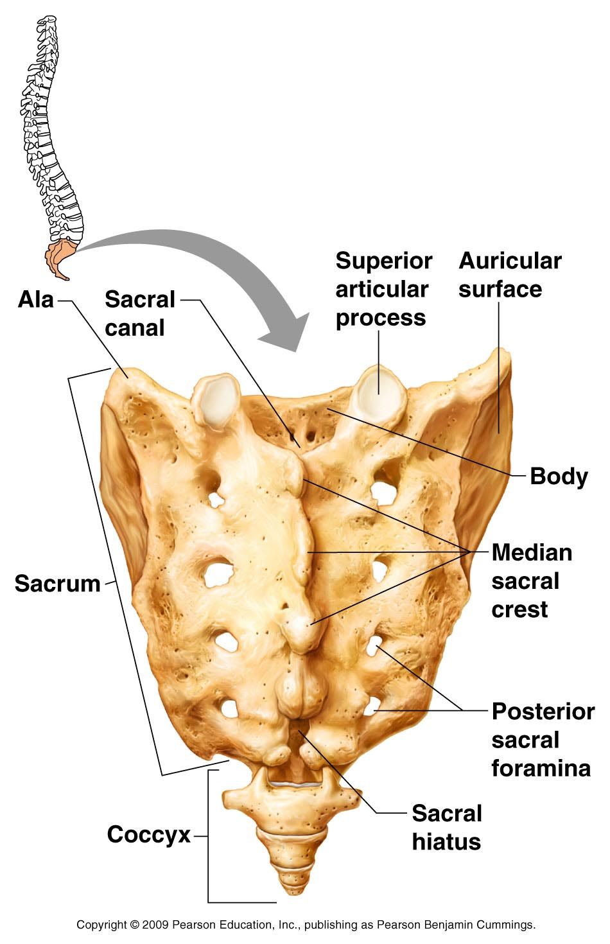
Sacrum and Coccyx
Figure 5.19

Slide 21
The Bony Thorax
Forms a cage to protect major organs
Consists of three parts
Sternum
Ribs
True ribs (pairs 1–7)
False ribs (pairs 8–12)
Floating ribs (pairs 11–12)
Thoracic vertebrae

Slide 22
The Appendicular Skeleton
Composed of 126 bones
Limbs (appendages)
Pectoral girdle
Pelvic girdle

Slide 23
The Appendicular Skeleton
Figure 5.6a

Slide 24
The Appendicular Skeleton
Figure 5.6b

Slide 25
The Pectoral (Shoulder) Girdle
Composed of two bones
Clavicle—collarbone
Scapula—shoulder blade
These bones allow the upper limb to have exceptionally free movement

Slide 26
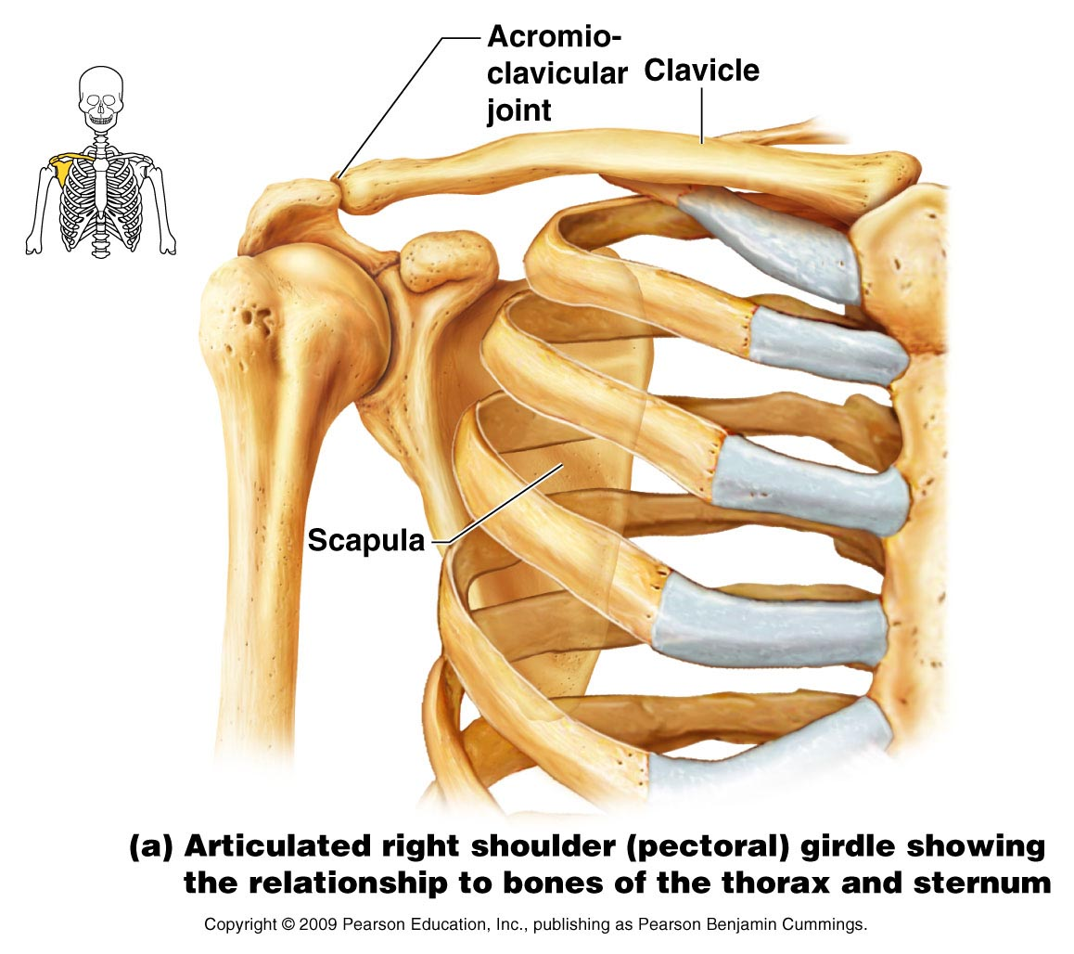
Bones of the Shoulder Girdle
Figure 5.21a

Slide 27
Gender Differences of the Pelvis
The female inlet is larger and more circular
The female pelvis as a whole is shallower, and the bones are lighter and thinner
The female ilia flare more laterally
The female sacrum is shorter and less curved
The female ischial spines are shorter and farther apart; thus the outlet is larger
The female pubic arch is more rounded because the angle of the pubic arch is greater

Slide 28
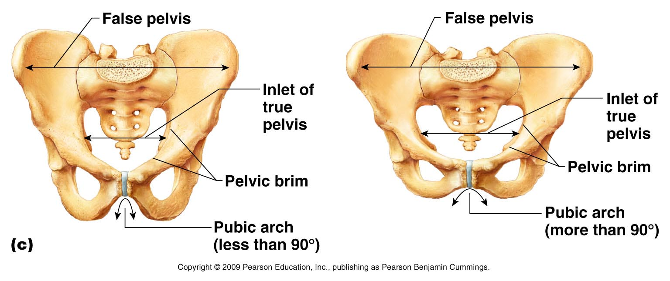
Gender Differences of the Pelvis
Figure 5.24c

Slide 29
Arches of the Foot
Bones of the foot are arranged to form three strong arches
Two longitudinal
One transverse

Slide 30
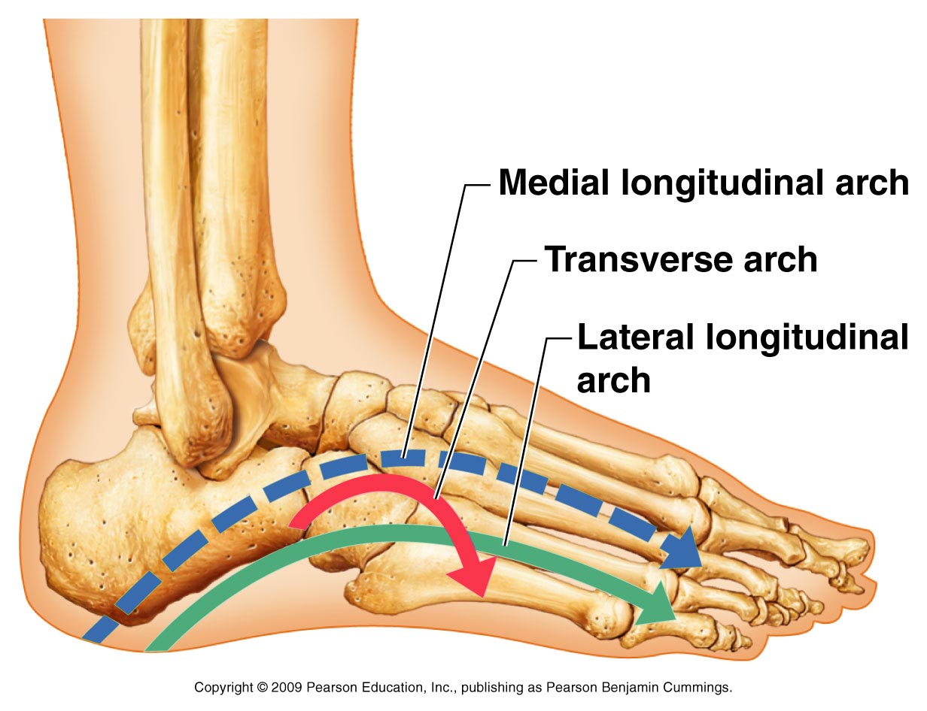
Arches of the Foot
Figure 5.27

